Slide 1
MVI_1973DLC_resnet50_spinalMotionsJan27shuffle1_200000
Without Data cleaning

Slide 2
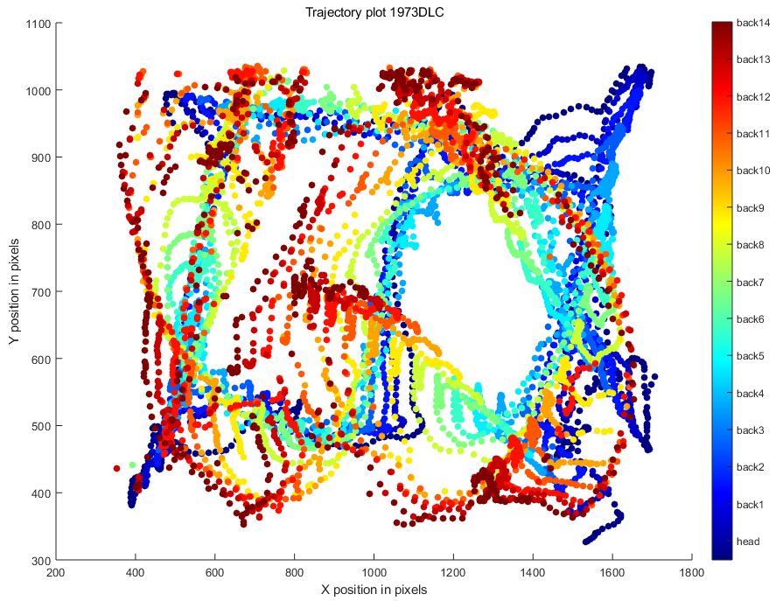

Slide 3
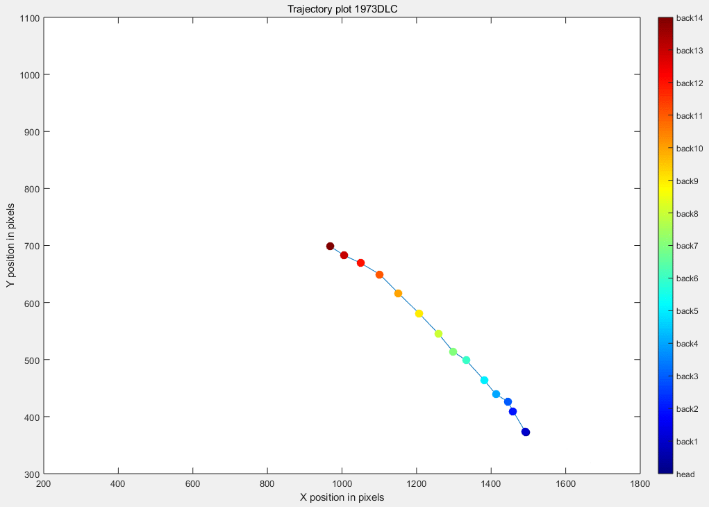

Slide 4
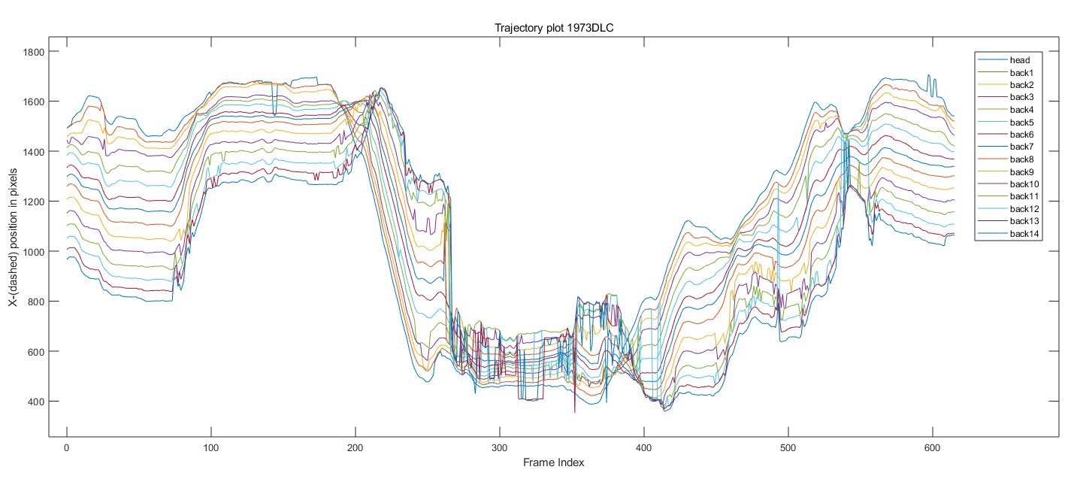

Slide 5
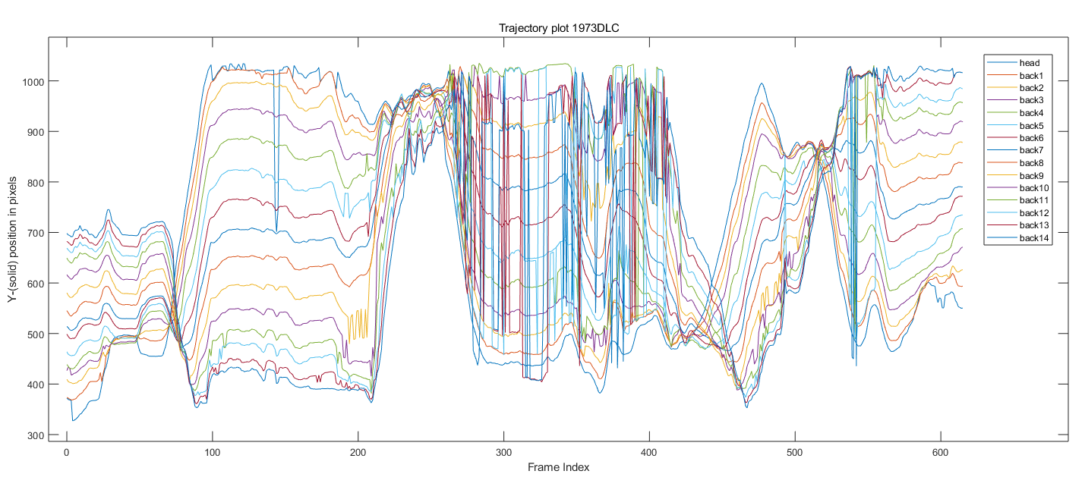

Slide 6
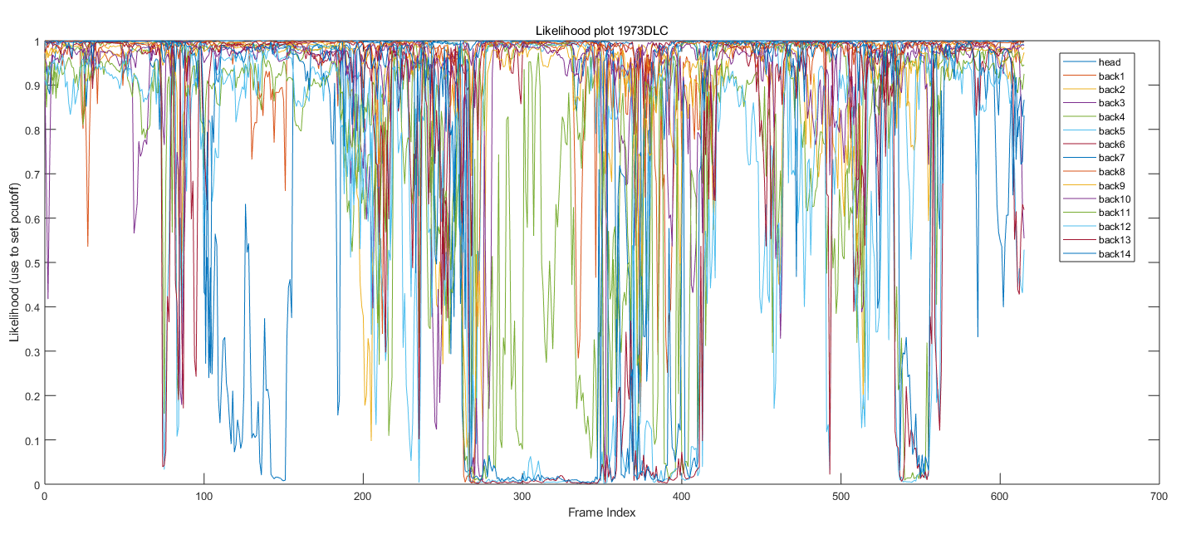

Slide 7
MVI_1973DLC_resnet50_spinalMotionsJan27shuffle1_200000
With Data cleaning

Slide 8
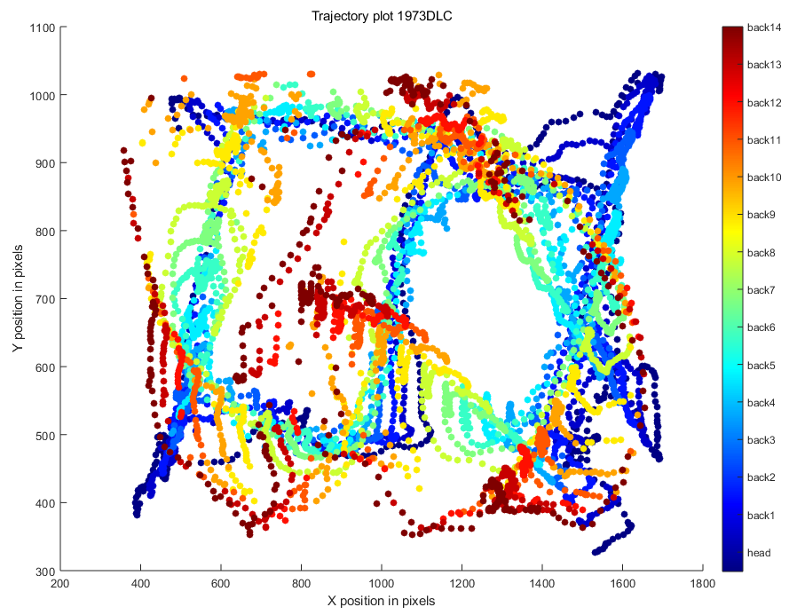

Slide 9


Slide 10
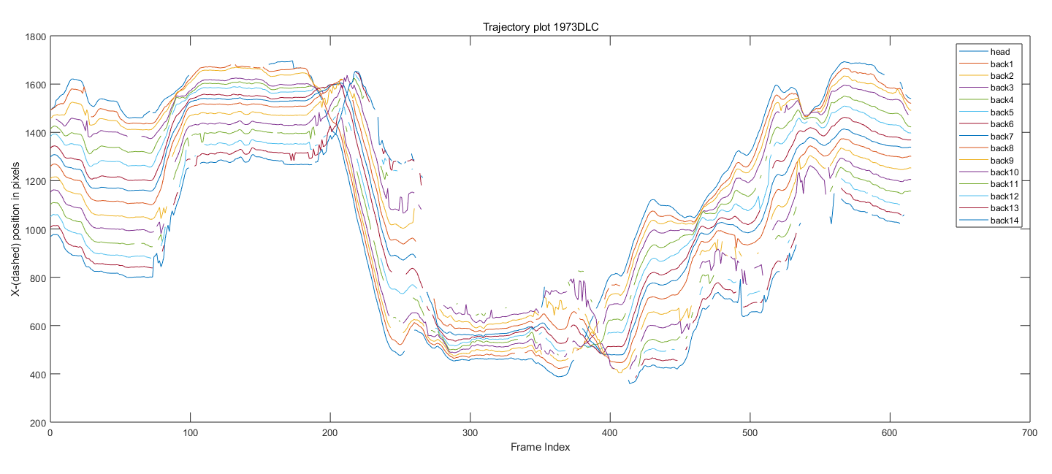
Do the parts of the data that are cleaned out need to be filled in with interpolation??

Slide 11
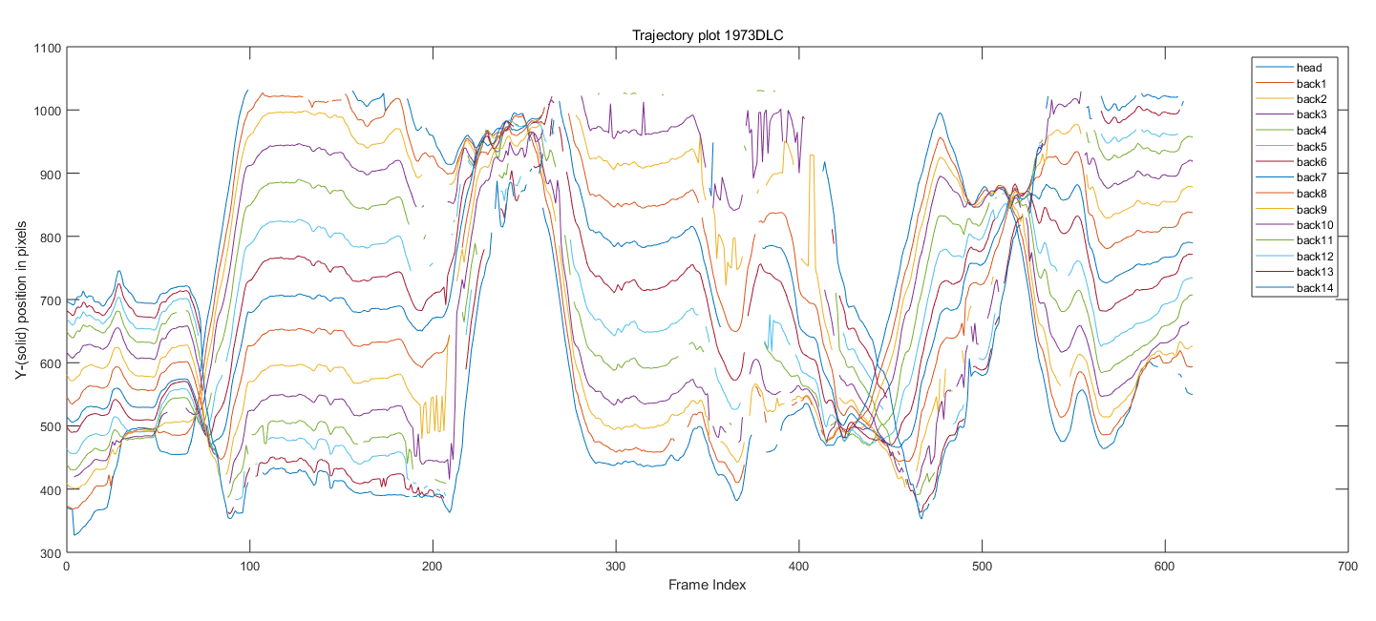
The frequency is too high and the curve is not flat, maybe the data is still faulty and needs further processing?

Slide 12
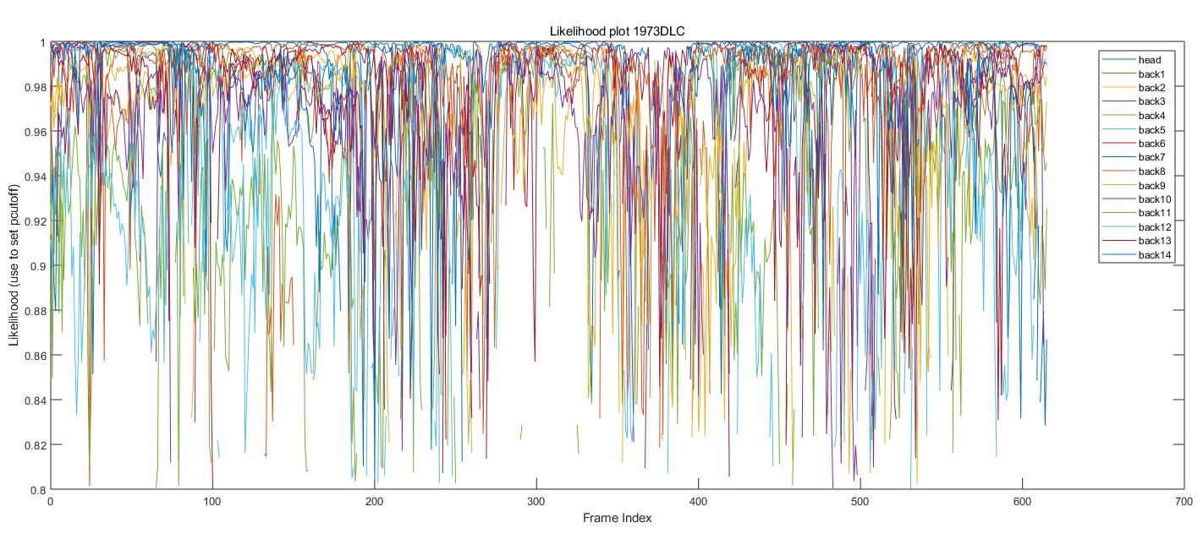

Slide 13
MVI_1978DLC_resnet50_spinalMotionsJan27shuffle1_200000
Without Data cleaning

Slide 14
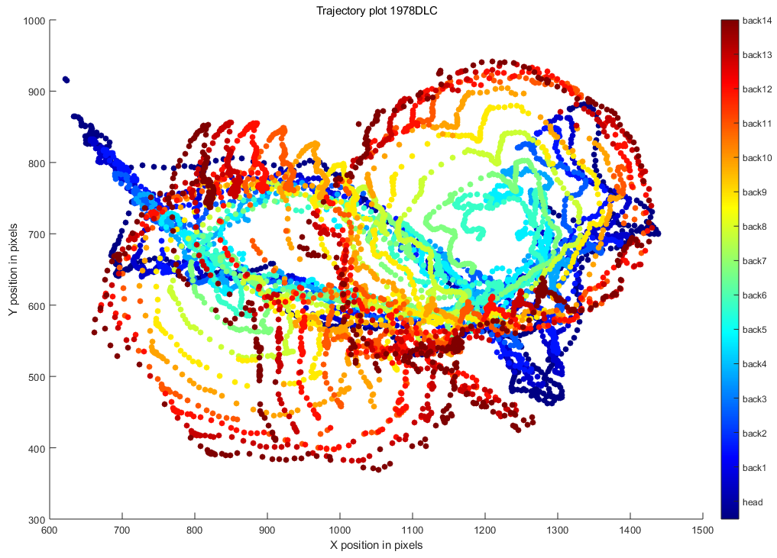

Slide 15
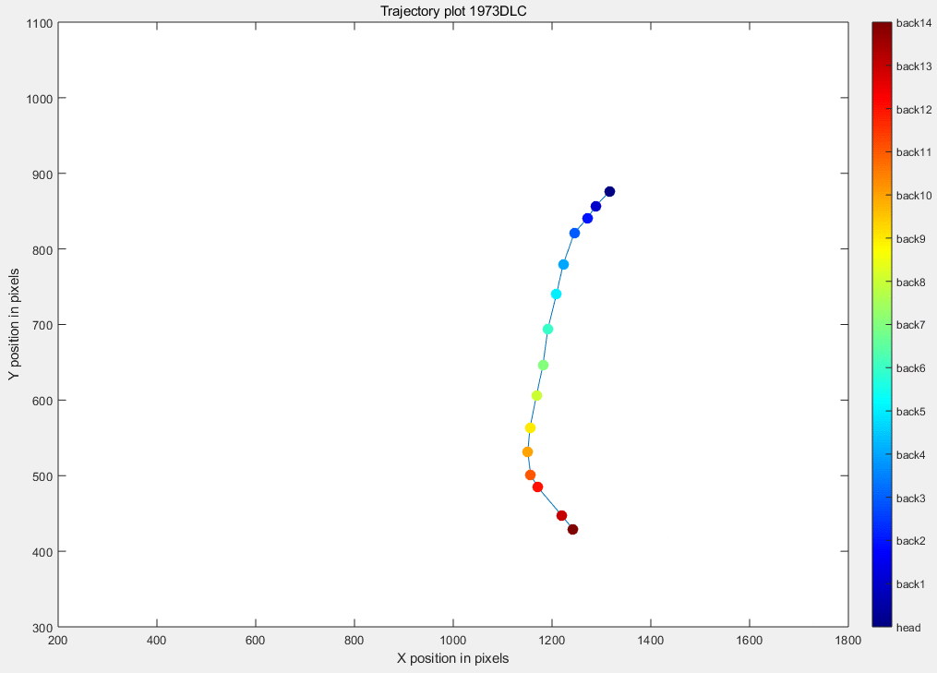
Trajectory plot 1978DLC

Slide 16
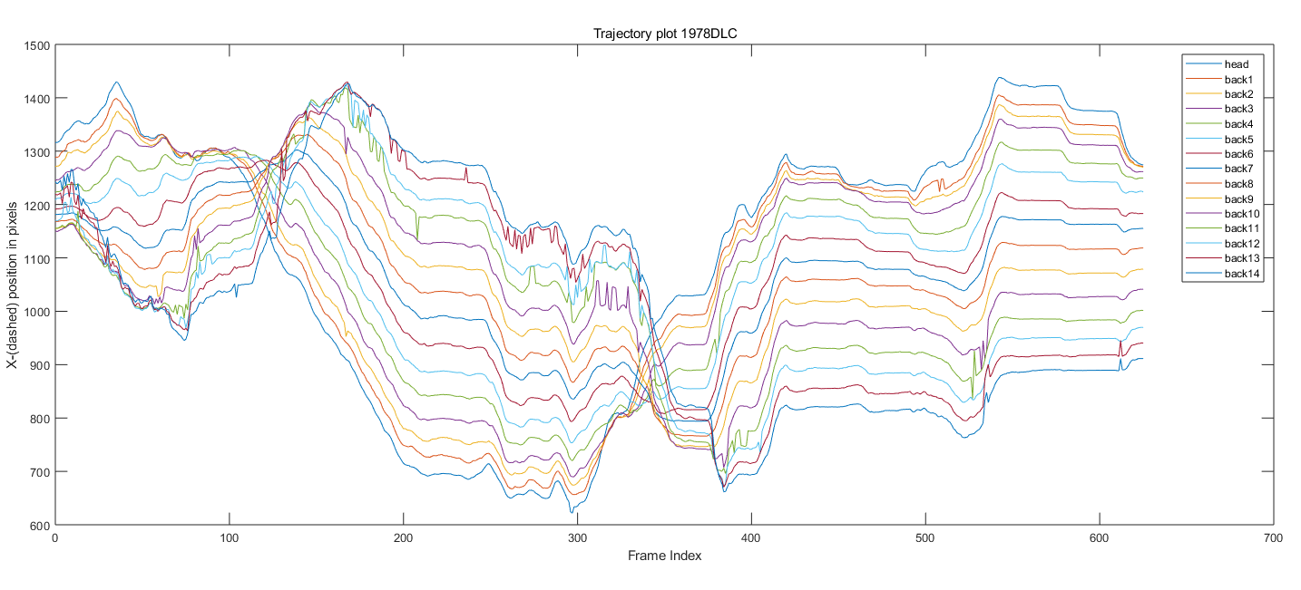

Slide 17
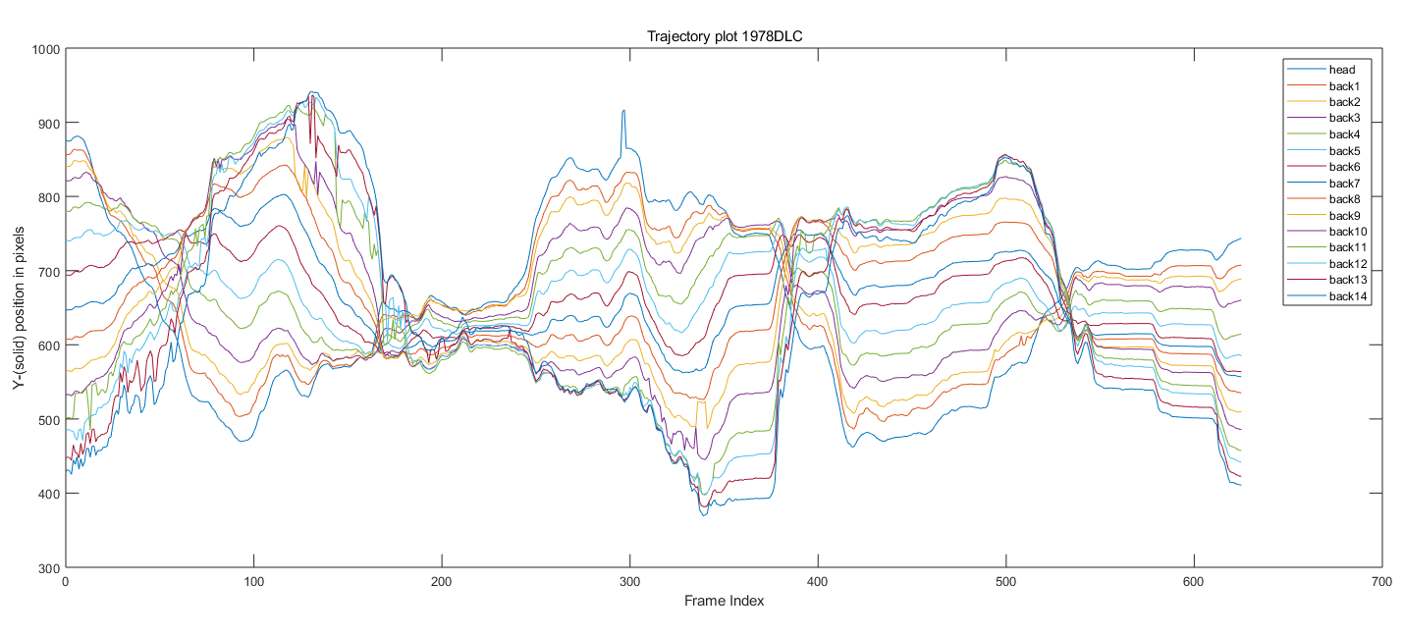

Slide 18
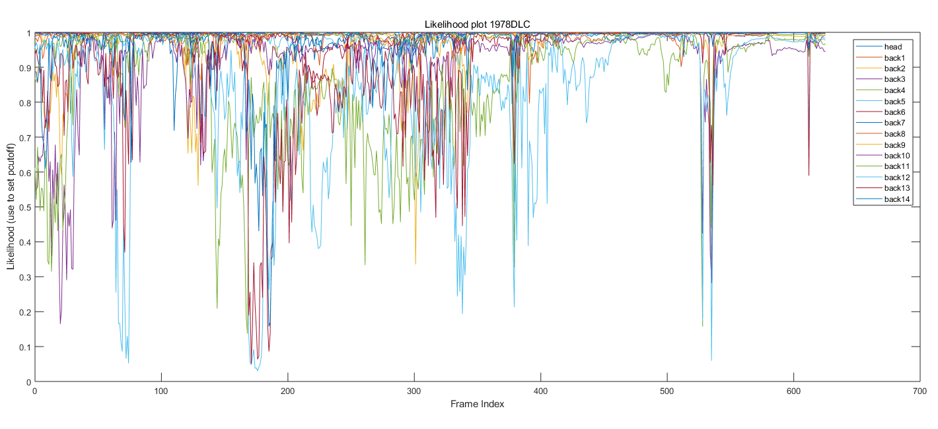

Slide 19
MVI_1978DLC_resnet50_spinalMotionsJan27shuffle1_200000
With Data cleaning

Slide 20
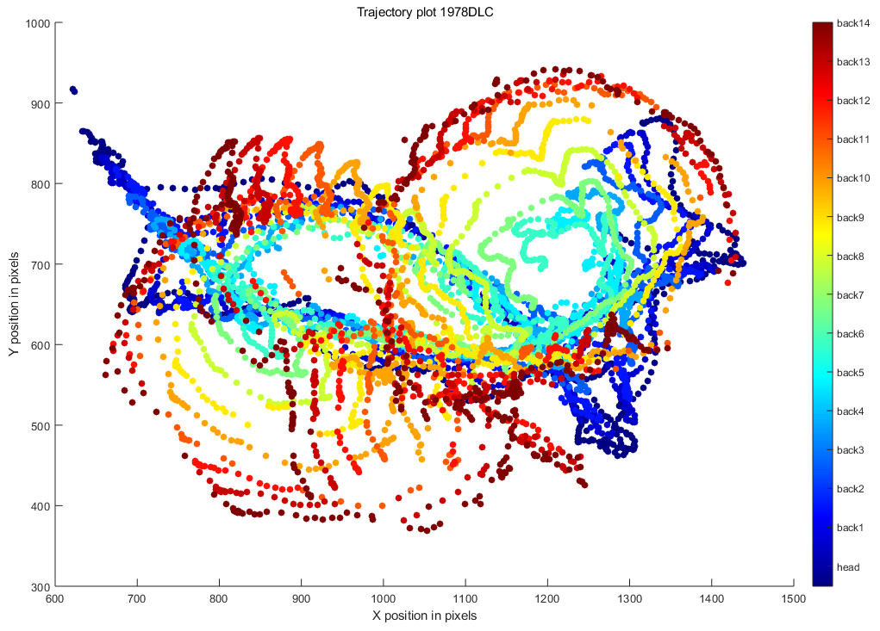

Slide 21
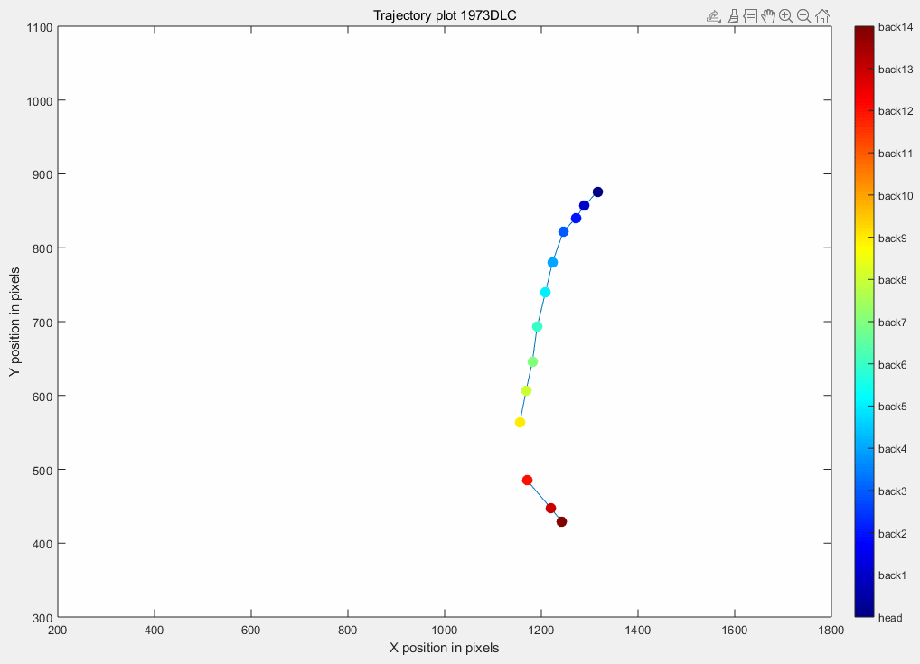
Trajectory plot 1978DLC

Slide 22
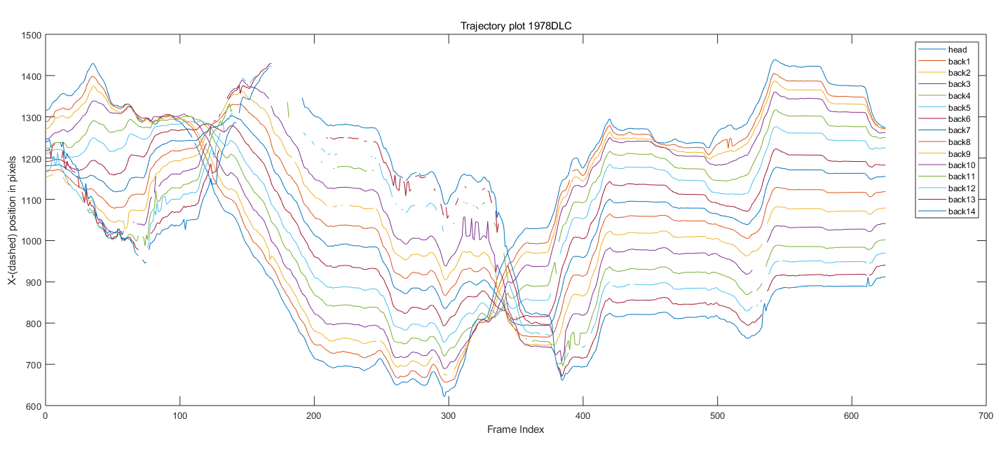

Slide 23
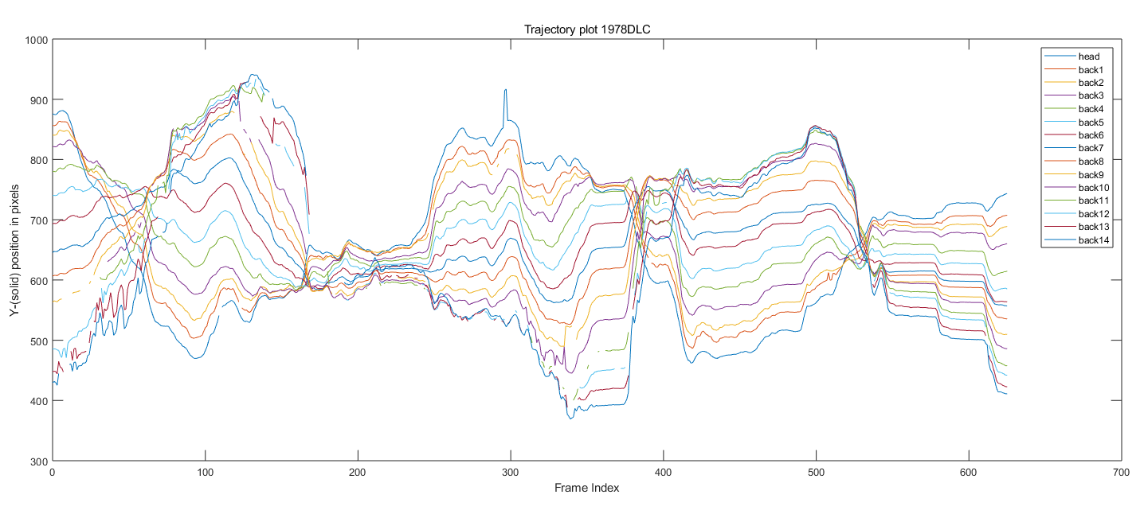

Slide 24
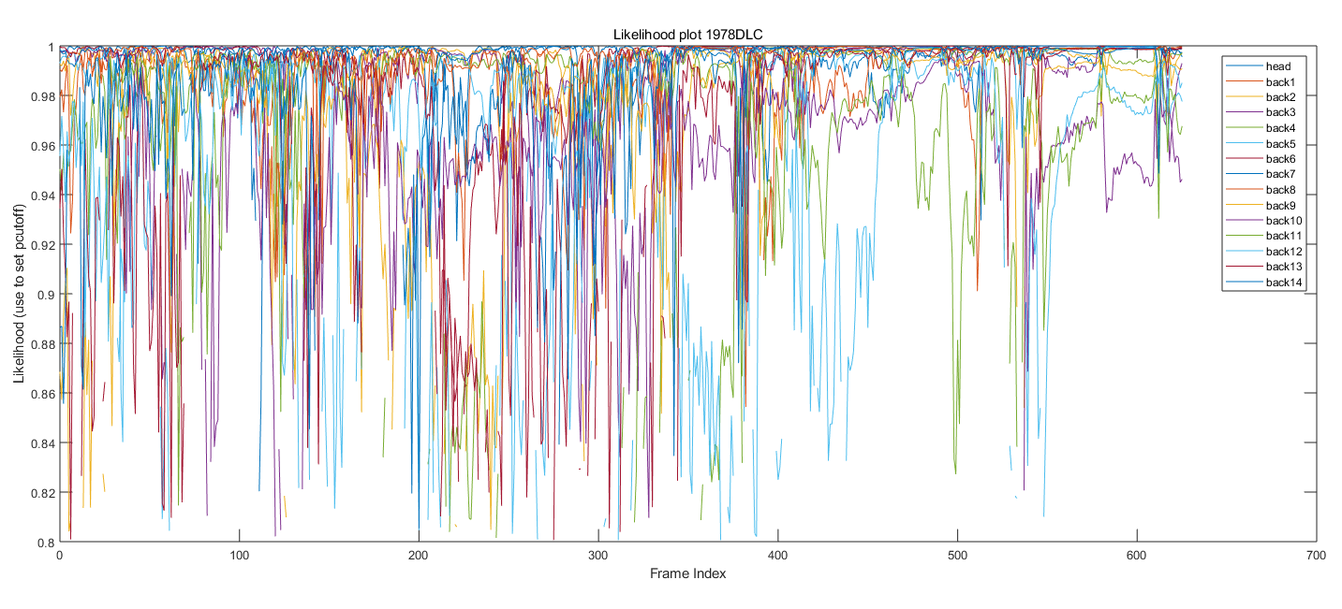

Slide 25
MVI_1980DLC_resnet50_spinalMotionsJan27shuffle1_200000
Without Data cleaning

Slide 26
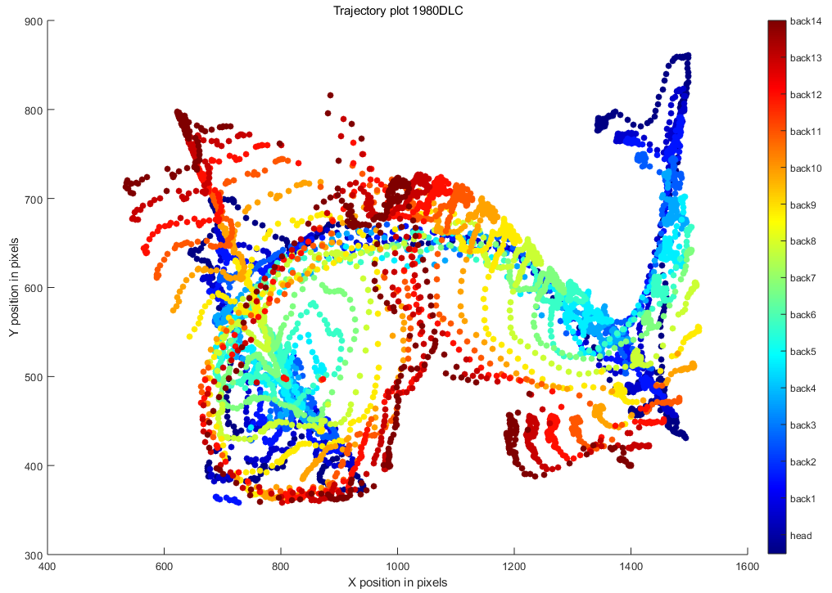

Slide 27
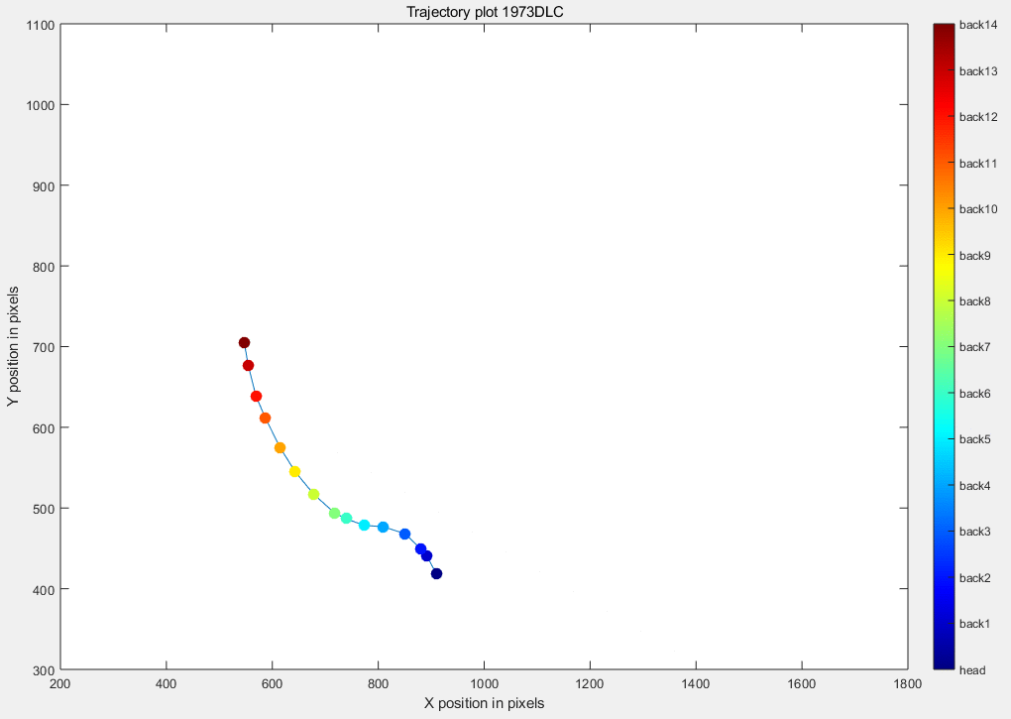
Trajectory plot 1980DLC

Slide 28
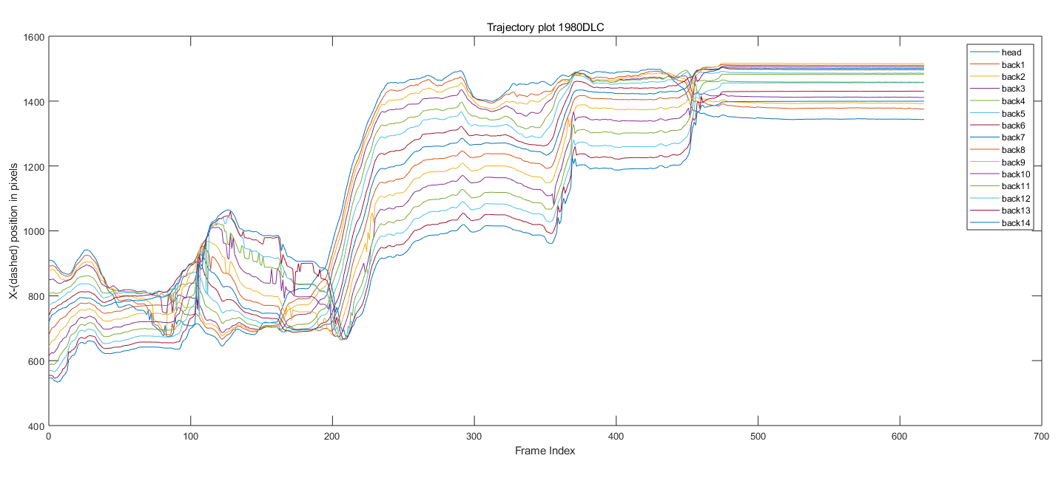

Slide 29
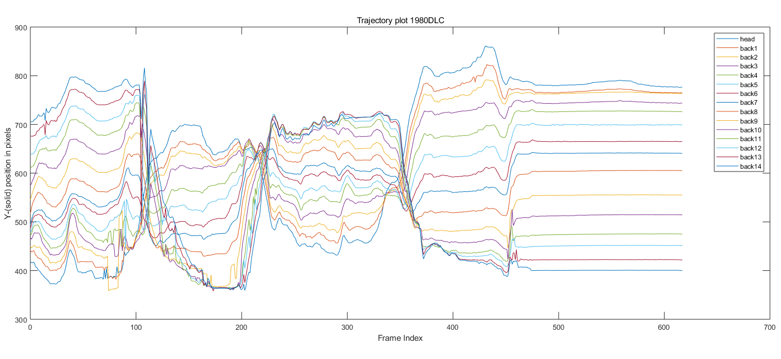

Slide 30
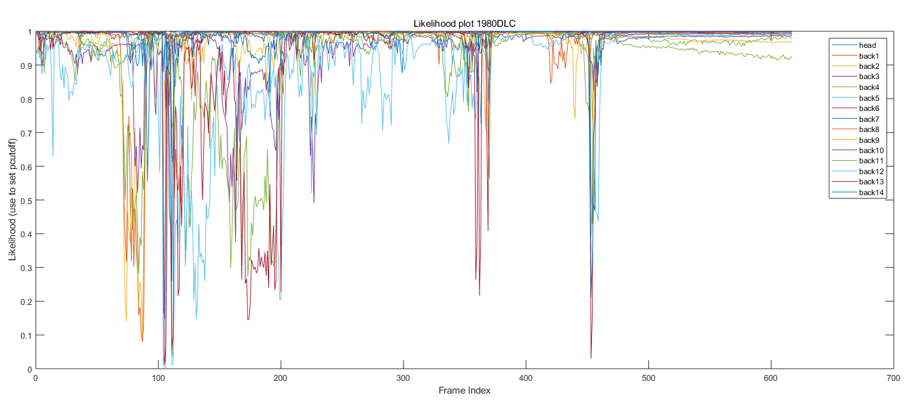

Slide 31
MVI_1980DLC_resnet50_spinalMotionsJan27shuffle1_200000
With Data cleaning

Slide 32
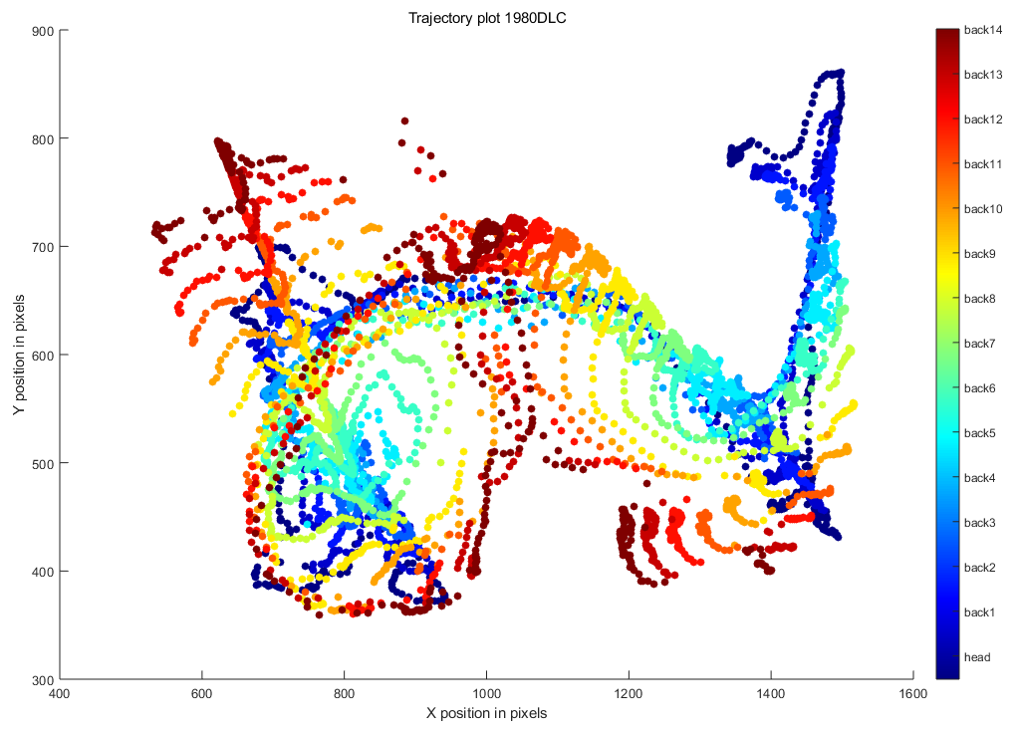

Slide 33

Trajectory plot 1980DLC

Slide 34
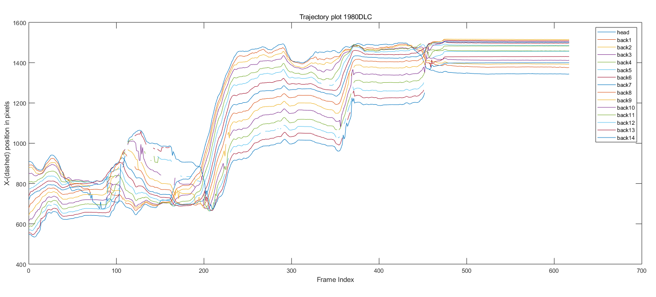

Slide 35
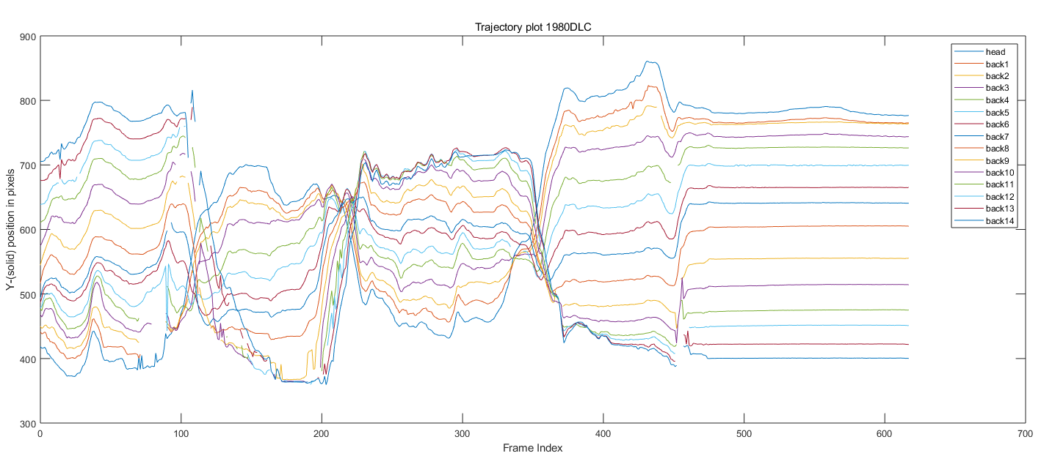

Slide 36
